Slide 1

SYLACE
INTRODUCTION TO
TABLEAU
Mehdi LAMRANI May 2020

Slide 2
SYLACE
GOALS :
Provide a broad and comprehensive introduction to Elastic Search Stack
Get Hands-On experience with queries
Build a complete pipeline

Slide 3

SYLACE
‘‘ Boxing is a science. You don't just walk into a gym and start punching.’’
Eddie Futch

Slide 4
SYLACE
A BIT OF HISTORY

Slide 5
SYLACE

Slide 6
SYLACE
Kafka is a publish/subscribe messaging system designed to solve the knot problem
Distributed commit log / Distributed streaming platform
A commit log is designed to provide a durable record of all transactions, so that they can be replayed to consistently build the state of a system

Slide 7
SYLACE
The unit of data within Kafka is called a message
Messages are written into Kafka in batches.
A batch is just a collection of messages, all of which are being produced to the same topic and partition.
Collecting messages together into a batch reduces overhead
Tradeoff between latency and throughput
Batches are compressed,
more efficient data transfer and storage (at the cost of some processing power).

Slide 8
SYLACE
Schemas
Messages are opaque byte arrays to Kafka itself
It is recommended that additional structure, or schema, be imposed on the message content.
Avro provides a compact serialization format that supports schemas and strong data typing.

Slide 9
SYLACE
Topics
Messages in Kafka are categorized into topics.
Topics are like a database table or a folder in a filesystem
Partitions
Topics are broken down into a number of partitions
Each partition is a single log
Messages are written to it in an append-only fashion, and are read in order
Time-ordering is not guaranteed across the entire topic, just within a single partition.
Partitions are the way that Kafka provides :
Distribution, parallelization, redundancy, and scalability.
Each partition can be hosted on a different server,
A single topic can be scaled horizontally across multiple servers.

Slide 10
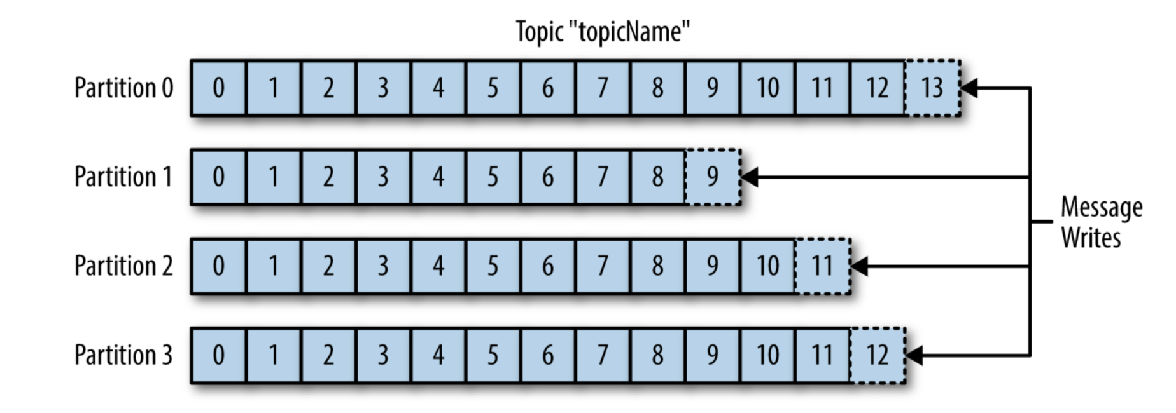
SYLACE

Slide 11
SYLACE
Producers & Consumers :
Pub Sub

Slide 12
SYLACE
Broker
A single Kafka server is called a broker
The broker
receives messages from producers,
assigns offsets
commits the messages to storage on disk
Services consumers

Slide 13
SYLACE
Cluster
Kafka brokers are designed to operate as part of a cluster.
Within a cluster of brokers,
one broker will function as the cluster controller (elected automatically from the live members of the cluster).
The controller is responsible for administrative operations,
assigning partitions to brokers
monitoring for broker failures.
A partition is owned by a single broker in the cluster (called the “leader” of the partition).
If a partition is assigned to multiple brokers, the partition is replicated

Slide 14
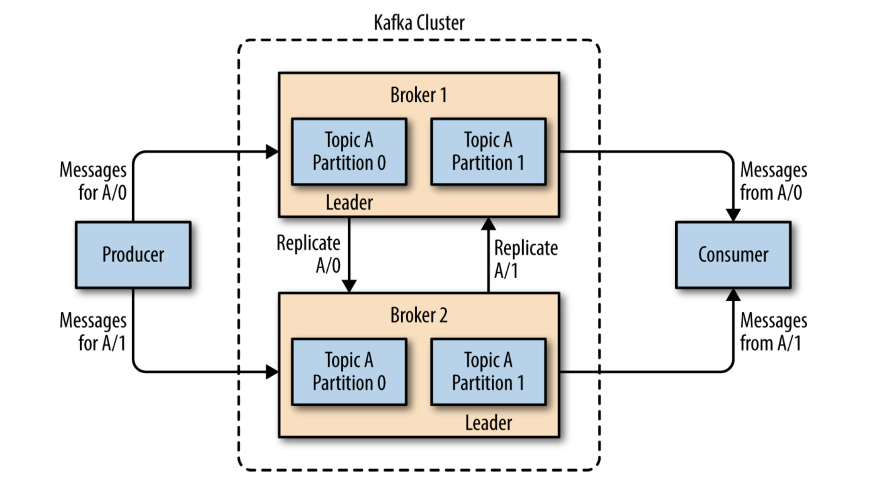
SYLACE

Slide 15
SYLACE
How Many Brokers ?
Required Disk Capacity
Example : 10TB => 5 Brokers x 2TB/Broker x 2 For Replication => 10 Brokers
Capacity to handle Requests

Slide 16
SYLACE
PRODUCERS

Slide 17
SYLACE
Kafka Producers
KafkaProducer
ProducerRecord

Slide 18
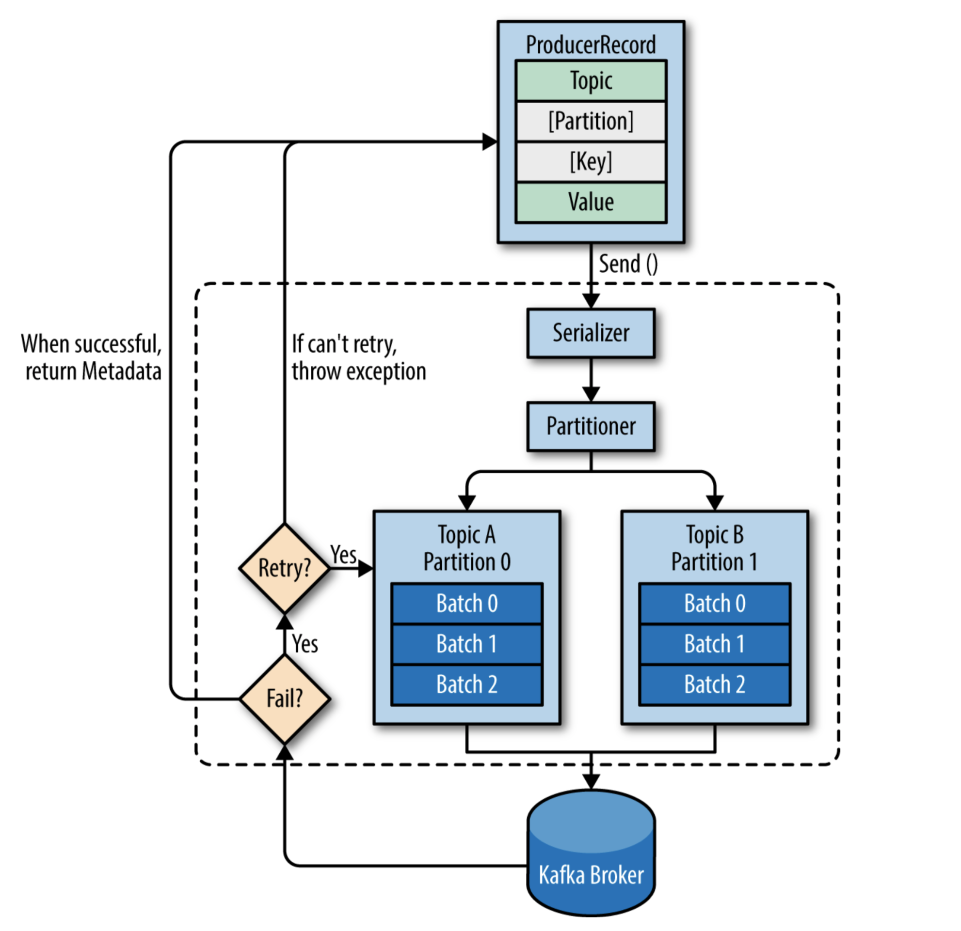
SYLACE

Slide 19
SYLACE
Fire-and-forget
Self explanatory. some messages will get lost using this method.
Synchronous send
send() method returns a Future object
use get() to wait on the future and see if the send() was successful
Asynchronous send
send( ) method is called with a callback function, which gets triggered when it receives a response from the Kafka broker.
Batching
When called, the send( ) method adds the record to a buffer of pending record sends This allows the producer to batch together individual records for efficiency

Slide 20
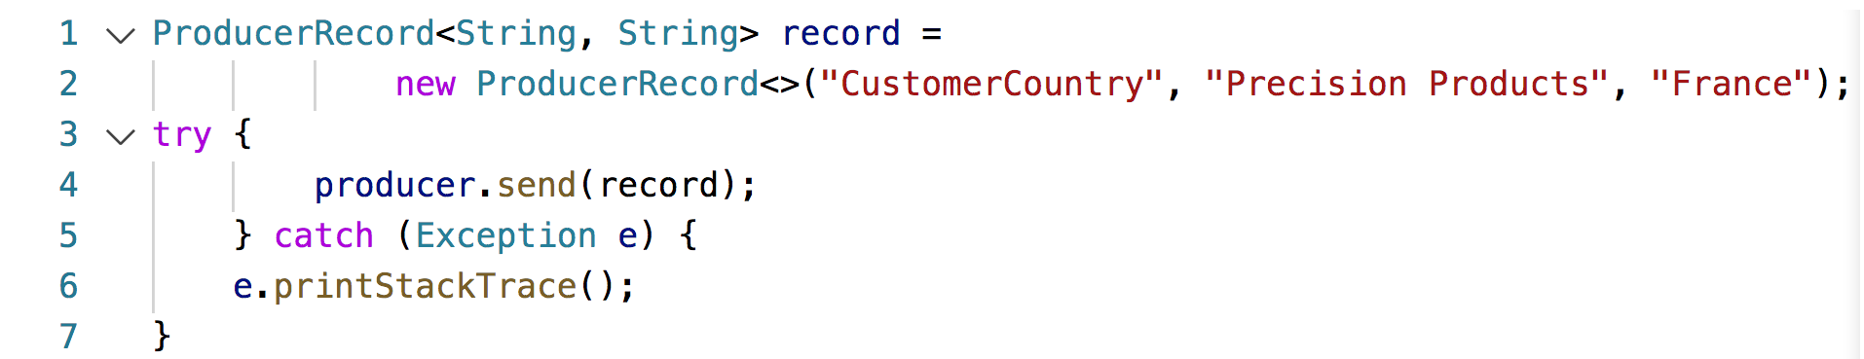
SYLACE
Fire-and-forget
Errors that may occur while sending messages to Kafka brokers or in the brokers themselves are ignored.
We may still get an exception if the producer encountered errors before sending the message to Kafka.
SerializationException when it fails to serialize the message,
BufferExhaustedException /TimeoutException if the buffer is full
InterruptException if the sending thread was interrupted

Slide 21
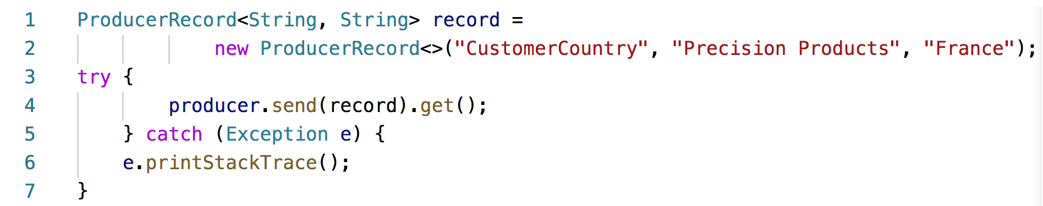
SYLACE
Synchronous send
The get method will throw an exception if the record is not sent successfully to Kafka.
If no errors, we will get a RecordMetadata object that we can use to retrieve the offset the message was written to.

Slide 22
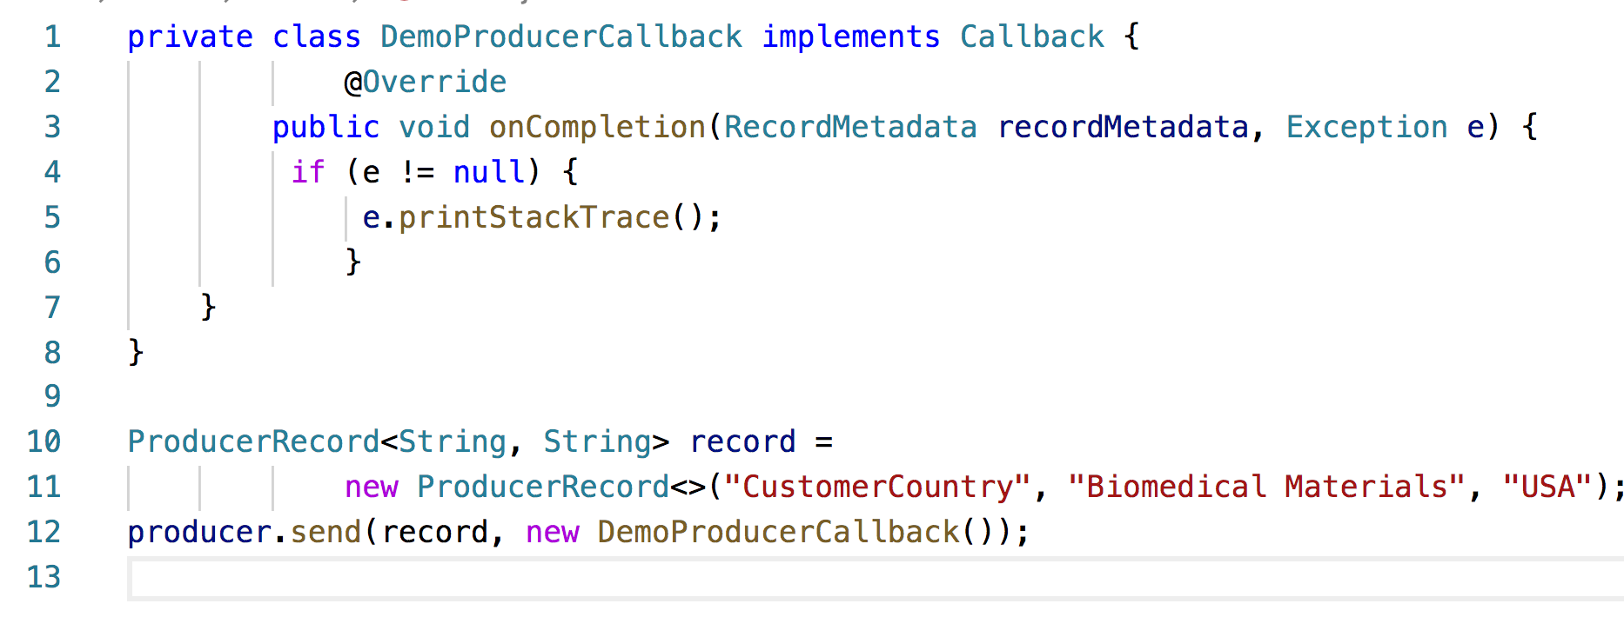
SYLACE
Asynchronous send

Slide 23

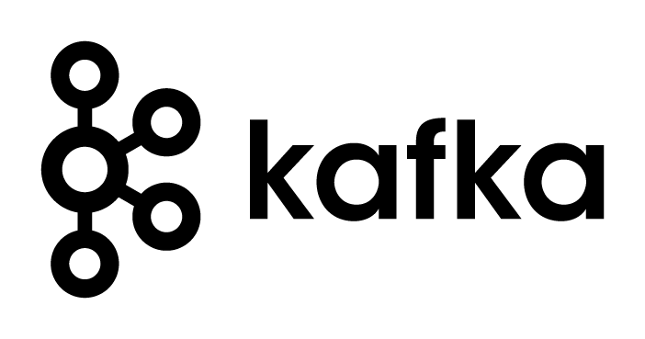
SYLACE
Multiple Producers
Multiple Consumers
Disk-Based Retention
Scalable
High Performance

Slide 24
SYLACE
KAFKA

Slide 25
SYLACE
Ordering Guarantee
Only intra partition order, (no inter-partition order)
If order is important Stick to a single partition or manage it applicatively.

Slide 26
SYLACE
SERIALIZERS

Slide 27
SYLACE
Serializers
Kafka writes bytes, natively
Built-in serializers : String, Integer, ByteArray
When the object is not a simple string or integer
Generic serialization library
Avro, Thrift, or Protobuf Generic
Write custom serializers

Slide 28
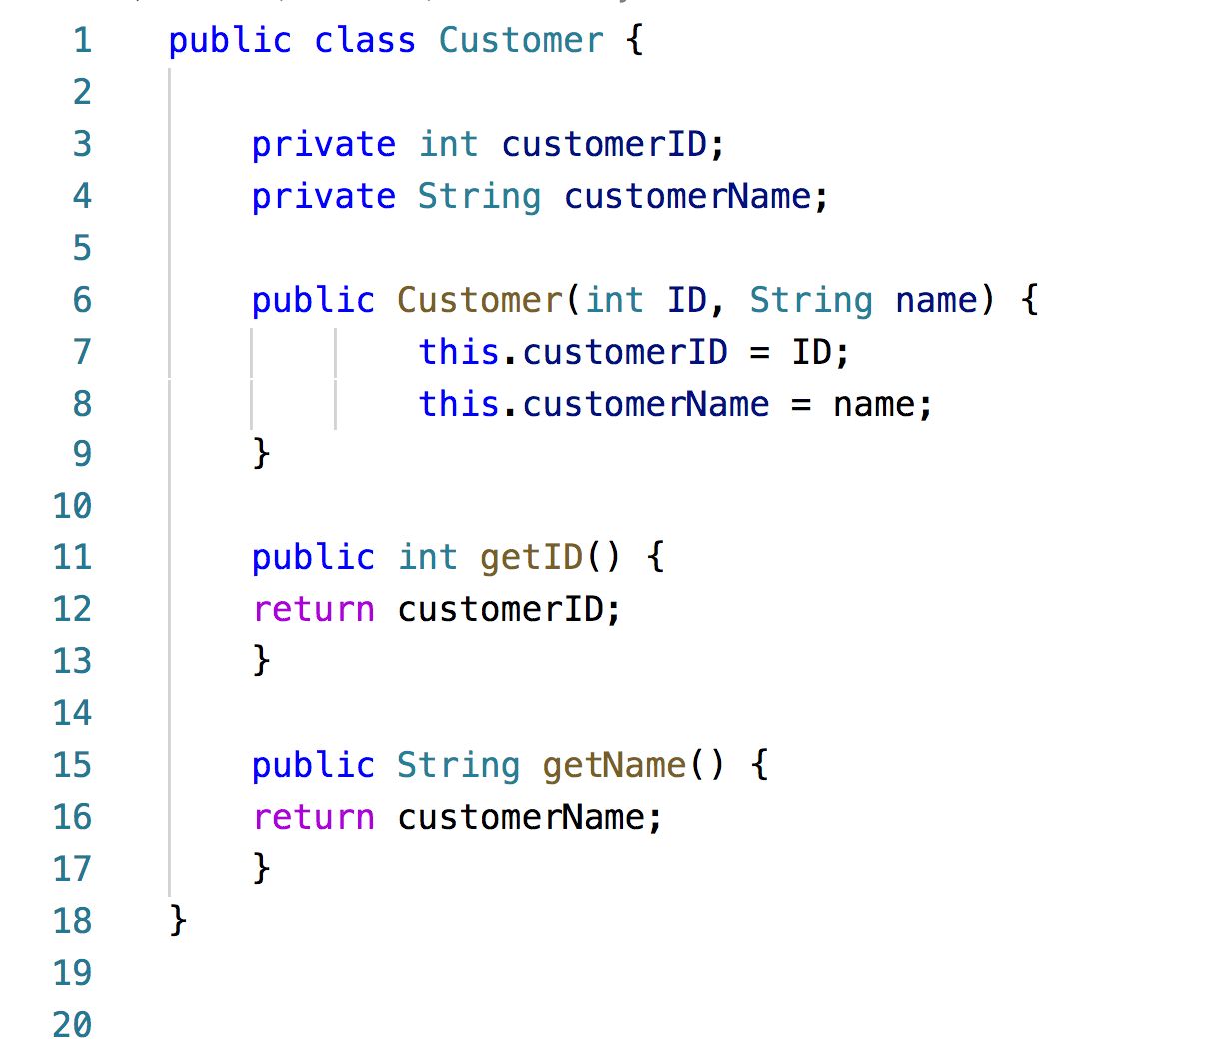
SYLACE
Customer Class

Slide 29
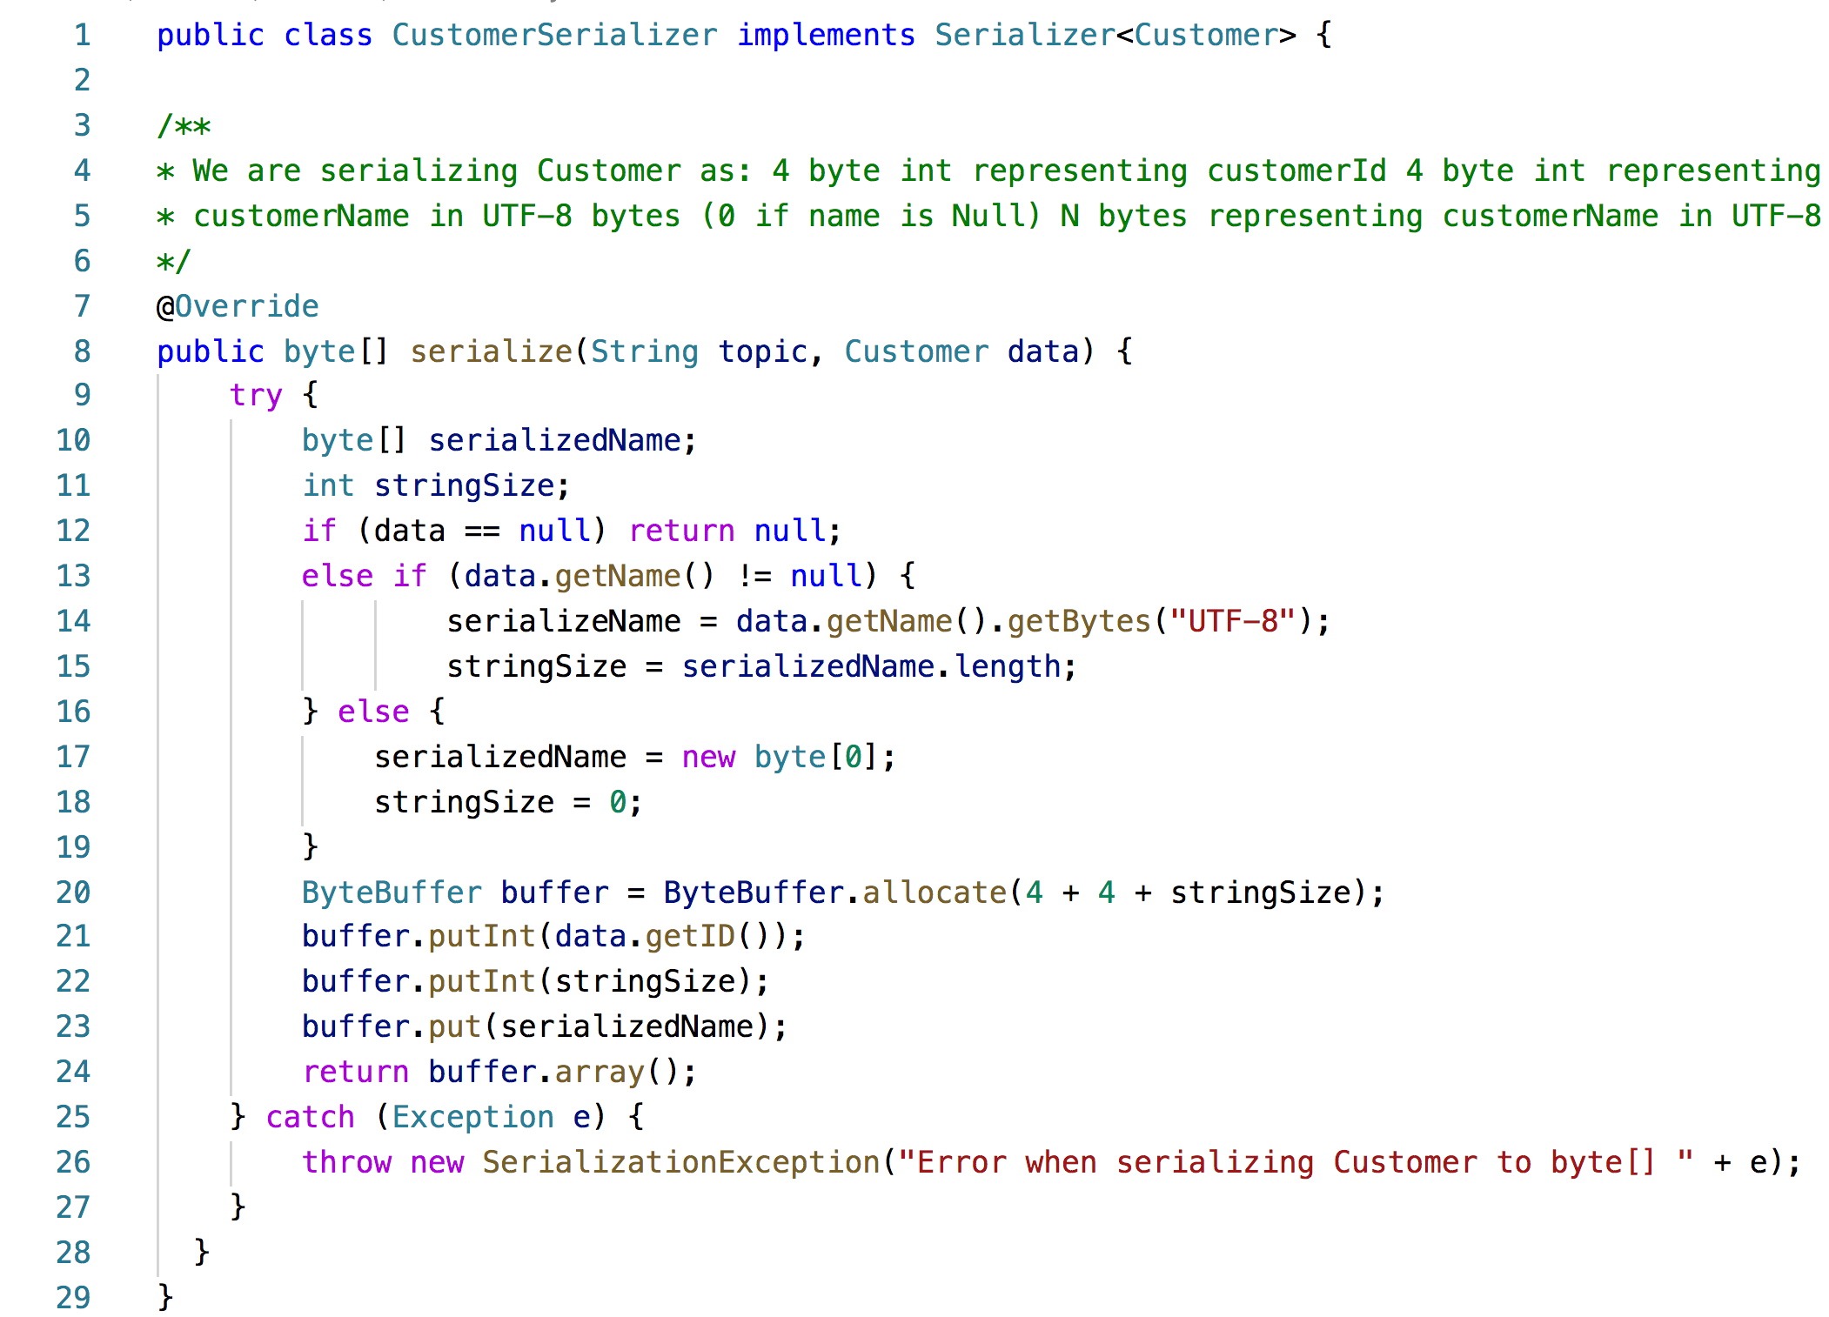
SYLACE
Customer Serializer

Slide 30
SYLACE
FAULT TOLERANCE
PART ONE

Slide 31
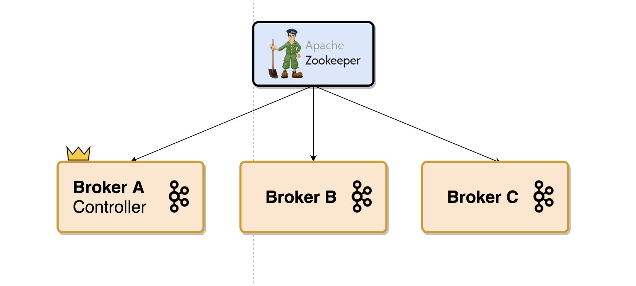

SYLACE
Le Roi est mort ☹

Slide 32
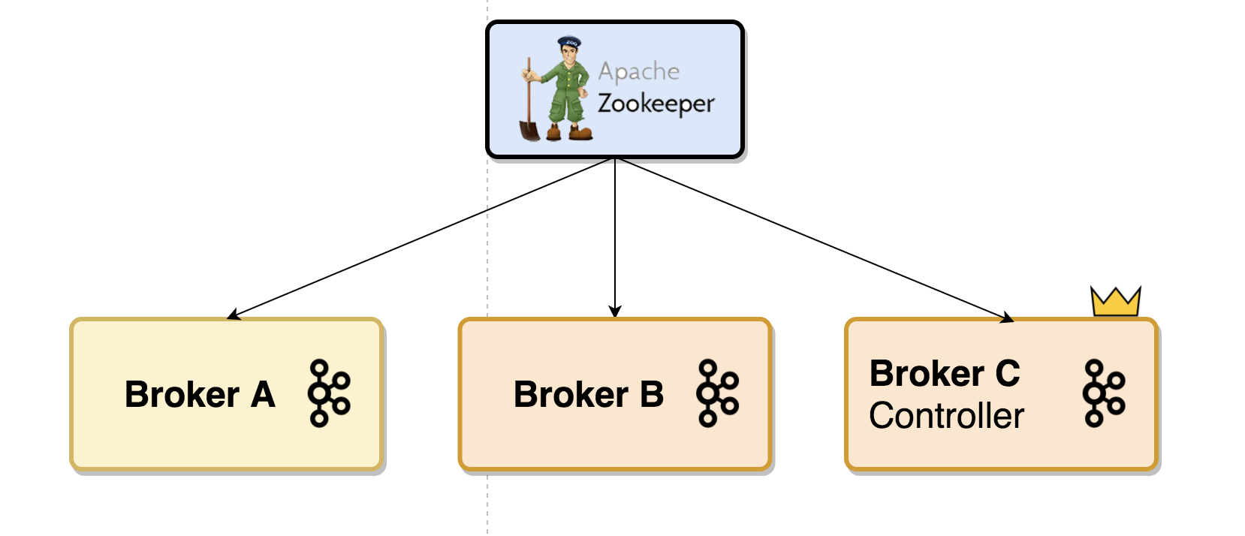
SYLACE
Vive le Roi ! ☺

Slide 33

SYLACE
…What if the king comes back?

Slide 34




SYLACE
?!?
Split Brain !

Slide 35
SYLACE
EPOCH to the rescue !
When the controller broker is stopped or loses connectivity to Zk , the ephemeral node will disappear.
Other brokers in the cluster will be notified through the Zk watch that the controller is gone and will attempt to create the controller node in Zk themselves.
The first node to create the new controller in Zk is the new controller, while the other nodes will receive a “node already exists” exception and re-create the watch on the new controller node.
Each time a controller is elected, it receives a new, higher controller epoch number (through a Zk conditional increment operation.)
The brokers know the current controller epoch and if they receive a message from a controller with an older number, they know to ignore it.

Slide 36
SYLACE
…What about partitions ?

Slide 37
SYLACE
REPLICATION

Slide 38

‘‘ It's always the small pieces that make the big picture.’’

Slide 39
SYLACE
Each topic is partitioned
Each partition can have multiple replicas.
Replicas are stored on brokers,
Each broker typically stores hundreds or even thousands of replicas belonging to different topics and partitions.
Partitions are broken down into segment (more to this later)

